Slide 1
V-RAG Virtual Reality Arena
Beyond The Human Limit
-FARDINA KABIR 1910080005

Slide 2
CONTENT
What Is Virtual Reality?
First Virtual Reality Setup?
What is Gaming?
Virtual Reality Gaming
Google Daydream
Targeted Audience
Timeline
User Persona
Mood Board
How VR Uses Biosignals or Brain Signals
Examples of neural VR growing in the tech arena.
Problems with previous vr headsets
Colour Pallet
Concept Sketches
Selected Concept
Final Concept
3D Modelling
Technical Measurements
Rendering
Key Features
Posters
Stories
References

Slide 3
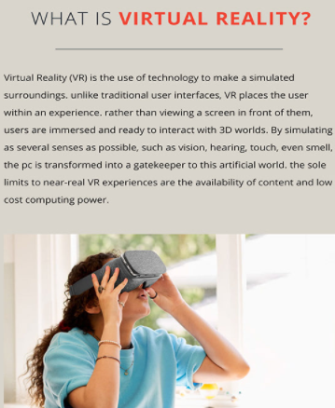
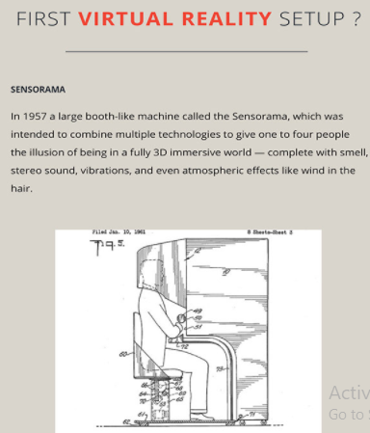
Bardi, J. (2021). What is Virtual Reality? VR Definition and Examples | Marxent. Retrieved 8 June 2021, from https://www.marxentlabs.com/what-is-virtual-reality/

Slide 4
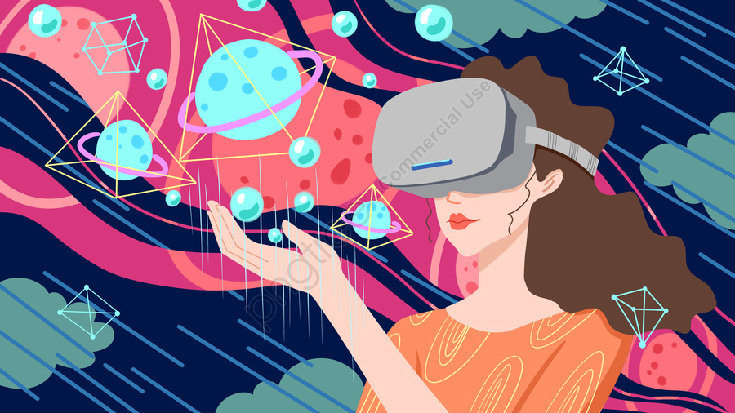
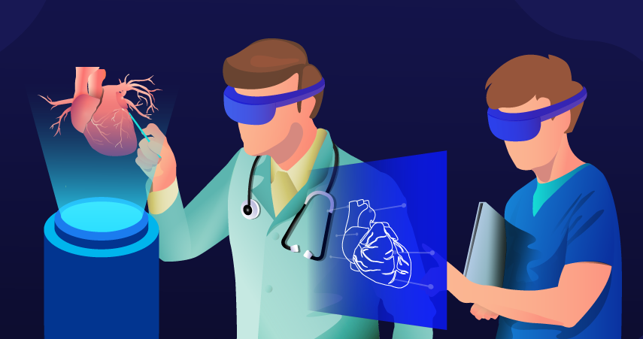
VIRTUAL REALITY AND ITS APPLICATIONS
Healthcare
VR is used for diagnosis, treatment, surgery, rehabilitation, counseling of patients, dentistry, medicine, nursing, surgery and simulation, reality therapies, phobia treatment, post traumatic stress disorder, treatment of autism, dealing with the physically-challenged, and several other health-related issues.
Entertainment
The entertainment industry is the one where the changes and developments in virtual reality will help to bring more excitement and thrill to the users. e.g. Oculus Cinema, allows users to watch a movie giving them the impression of watching it all alone – a major attraction for cinema buffs. In addition, VR provide an immersive experience of concerts without the rowdenning crowds.
Khanna, C. (2021). Virtual Reality and its Applications Across Industries. Retrieved 8 June 2021, from http://www.bodeanimation.com/blog/virtual-reality-and-its-applications-across-industries/

Slide 5
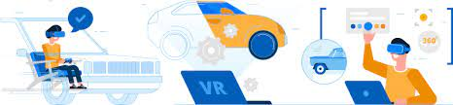
VIRTUAL REALITY AND ITS APPLICATIONS
Automotive
The benefit for the car companies is that they can make improvements and necessary changes to a proposed car model, without actually building a prototype. In addition, some car manufacturers use VR to educate parents and young adults about the dangers of distracted driving.
Advertising
An apparel brand asks users to wear their company’s trekking shoes and set up an experience where the user is able to ‘undertake’ treks in some of the most dangerous routes and mountains. The users gain first-hand information of the utility and durability of the shoes and the authenticity of the company’s claims. With customers becoming smarter and having more options to choose from, such experiences put the control in their hands, by allowing them to ‘experience’ a product even before buying it.
Skilled Occupations
New recruits and trainees benefit by ‘practicing’ their craft several times, without money being spent on actual materials to train them. The users can repeat the task as many times as they need to, in order to increase their skill levels for the trade they have chosen., VR training makes the process a lot faster, cheaper, and more thorough.
Khanna, C. (2021). Virtual Reality and its Applications Across Industries. Retrieved 8 June 2021, from http://www.bodeanimation.com/blog/virtual-reality-and-its-applications-across-industries/

Slide 6
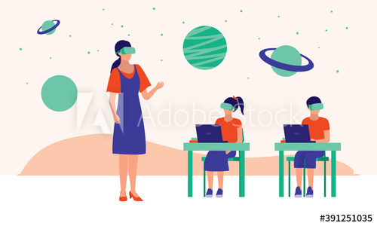
VIRTUAL REALITY AND ITS APPLICATIONS
Education
Virtual Reality increases scope of training, benefiting users – ranging from students to top surgeons. In schools, VR in the classrooms means that irrespective of the limitations of space, poor weather, and personnel, the children can still be part of field trips and immersive gaming. The applications developed, help to minimize the effects of the physical challenges, thereby improving QOL by enhancing social participation, improving mobility and cognition, and providing exciting and interesting experiences of children battling disabilities.The children feel a sense of control over their stimulus in the VR environment, which increases their confidence and boosts their morale. It empowers them with freedom to move, allowing them to get the feeling of overcoming the disabilities.
Khanna, C. (2021). Virtual Reality and its Applications Across Industries. Retrieved 8 June 2021, from http://www.bodeanimation.com/blog/virtual-reality-and-its-applications-across-industries/

Slide 7

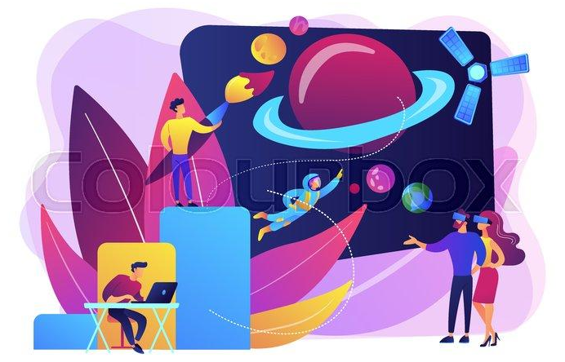
VIRTUAL REALITY AND ITS APPLICATIONS
Tourism
Planning, management, marketing, education, entertainment, and even heritage preservation are some of the key areas of tourism for which VR would prove particularly useful. Creating awareness and promoting locations is a huge potential for VR – prospective visitors can ‘experience’ proposed destinations and decide which one would be best for them. The tools within the VR realm allow users to feel wind and the sun on their face, experience hiking and boat rides, and other such experiences.
Space
VR has been in use at NASA – to enhance training and provide better development opportunities for the new recruits and existing employees. Major use of VR for this realm is the creation of a virtual space centre, which is interactive and is aimed at improving the mental and physical health of astronauts on long-term space missions.
Khanna, C. (2021). Virtual Reality and its Applications Across Industries. Retrieved 8 June 2021, from http://www.bodeanimation.com/blog/virtual-reality-and-its-applications-across-industries/

Slide 8
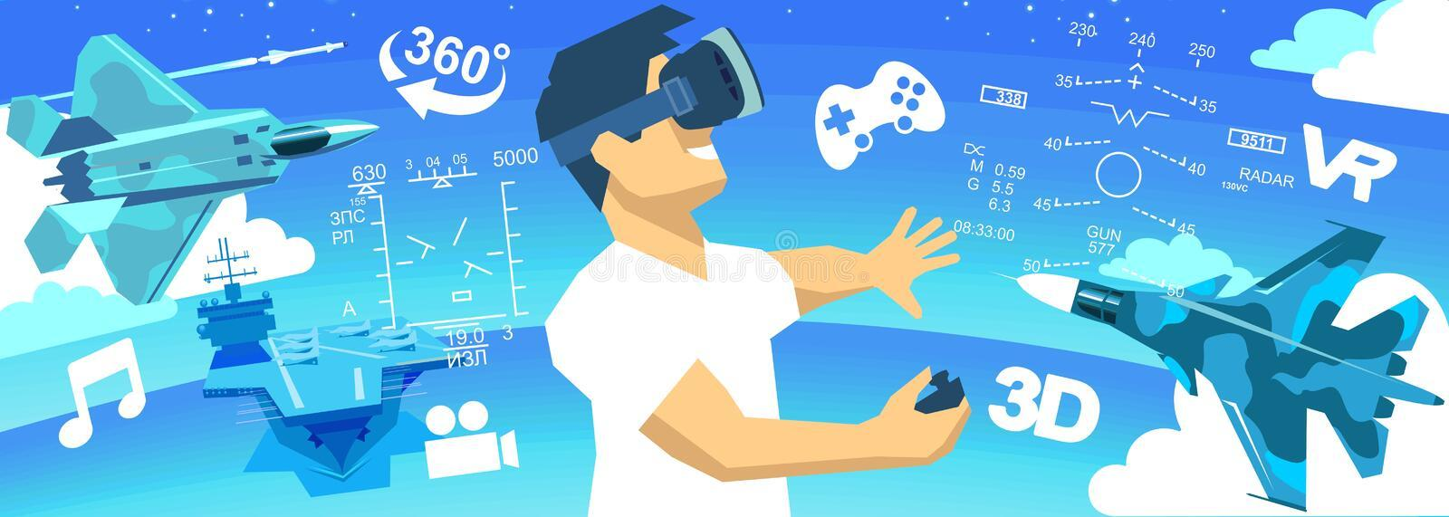
VIRTUAL REALITY AND ITS APPLICATIONS
Law Enforcement and Military
A country’s government incorporated the Oculus Rift device to train their military and law enforcement medics in dealing with trauma during battle. The device helps the military by using replications of situations to deal with IEDs (improvised explosive devices) and other situations. Since these situations can be repeated several times, the learning is a lot better, and the personnel is able to learn from their own mistakes and those of others, without putting themselves in actual danger.
Khanna, C. (2021). Virtual Reality and its Applications Across Industries. Retrieved 8 June 2021, from http://www.bodeanimation.com/blog/virtual-reality-and-its-applications-across-industries/

Slide 9
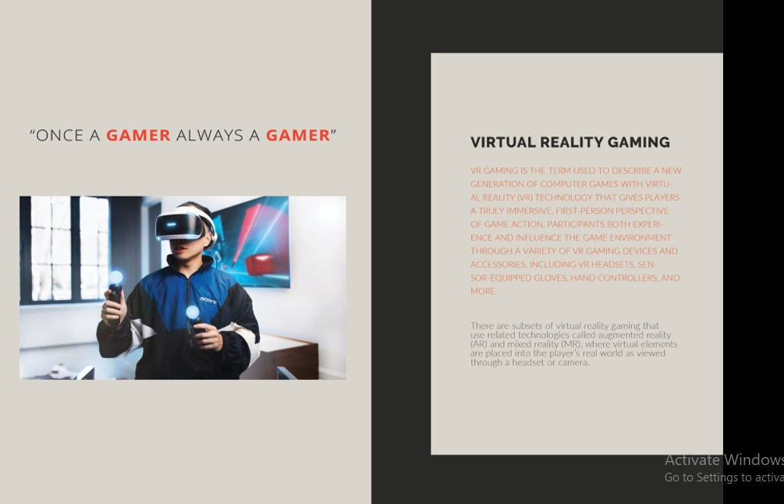
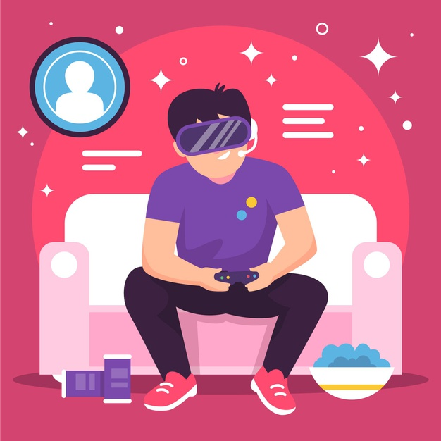
Khanna, C. (2021). Virtual Reality and its Applications Across Industries. Retrieved 8 June 2021, from http://www.bodeanimation.com/blog/virtual-reality-and-its-applications-across-industries/

Slide 10
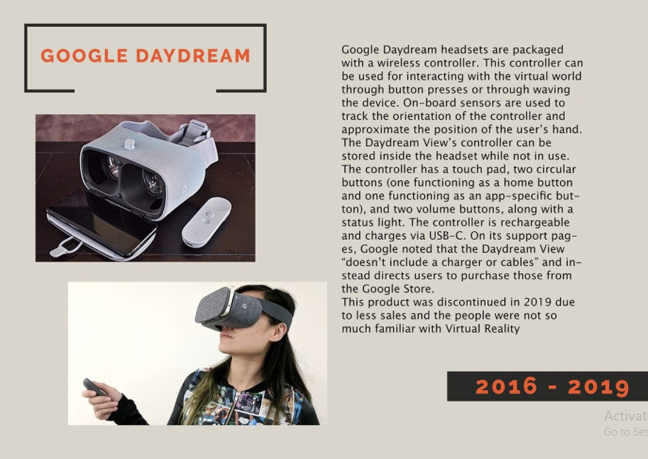
Daydream – Developers. (2021). Retrieved 8 June 2021, from https://arvr.google.com/daydream/developers/

Slide 11
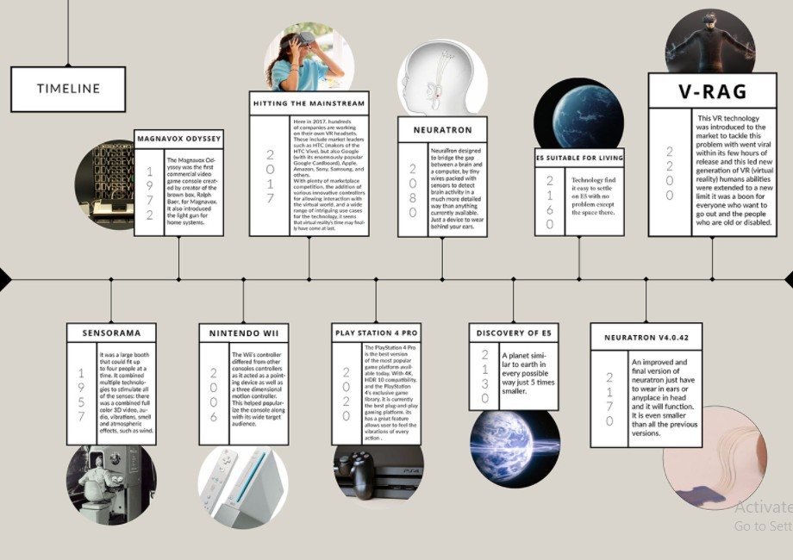

Slide 12
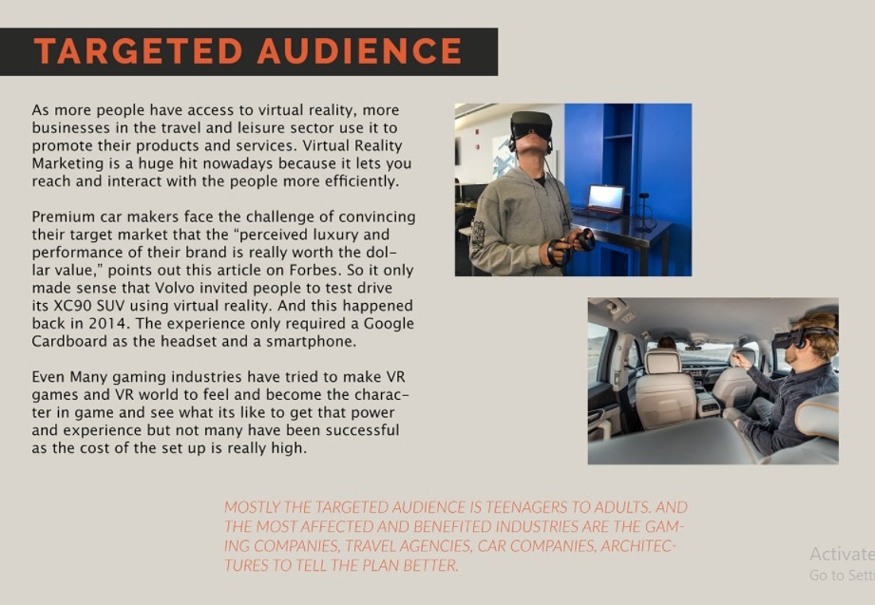

Slide 13
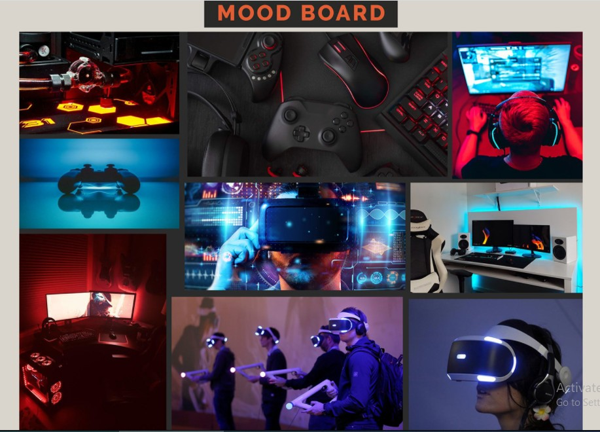

Slide 14
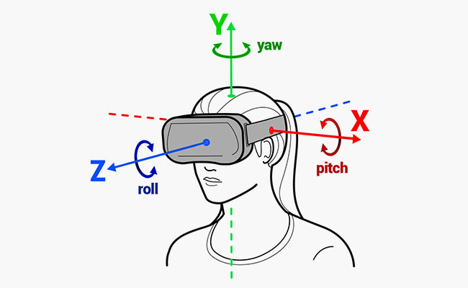
How VR Uses Biosignals or Brain Signals
Harnessing the Power of Brain Waves in Virtual Reality: Applications for Gaming and Medicine. Users use a headset provided with VR goggles that are attached to sensors that can read and process and translate their brainwaves into actual movement in the VR world. VR is focused on deciphering brain activity to determine a person’s intention, particularly in virtual and augmented reality. This is the first step in a giant leap towards controlling VR games with only our thoughts.For the VR headsets to work, a computer or smartphone has to be installed. Video is sent from the console to the VR headset. The display inside the VR headset has two LCD display screens.
The headset creates a 3D environment by angling several 2D images at a minimum frame rate of at least 60 frames per second. Another feature is head-tracking. Headsets use degrees of freedom (DoF). This allows the headset to look at our head’s position in terms of the X, Y, and Z axes to measure our head movements. Additional equipment for head tracking includes a gyroscope and an accelerometer. The gyro sensors constantly send information to the display driver to change the orientation of the screen according to the user’s action, allowing movement in multi-directions. The accelerometer’s primarily function is to let the system know which way we are facing, as well as also measures the acceleration along a particular axis.
Zanier, E. R. (2018, May 6). Virtual Reality for Traumatic Brain Injury. U.S. National Library of Medicine. https://www.frontiersin.org/articles/10.3389/fneur.2018.00345/full

Slide 15
How VR Uses Biosignals or Brain Signals
Audio is incorporated in order to immerse the user. Developers use 3-D audio that manipulates the in-game sound to give users the feeling that sound is coming from all directions. This method tricks our brain by using the ears and the auditory nerves, pretending to play different sounds in different 3-D locations, even though the sounds are only produced by a couple of speakers. By carefully executing the timing, direction, and echo characteristics of each sound that is played, engineers are able to create this 3-D audio environment.
Thus, users will receive sounds from all directions. This is a major leap forward from the current dual-stereo headphones, which only project sound from the left and right, that we currently use.Audio is incorporated in order to immerse the user. Developers use 3-D audio that manipulates the in-game sound to give users the feeling that sound is coming from all directions.
This method tricks our brain by using the ears and the auditory nerves, pretending to play different sounds in different 3-D locations, even though the sounds are only produced by a couple of speakers. By carefully executing the timing, direction, and echo characteristics of each sound that is played, engineers are able to create this 3-D audio environment.
(Omejc, Nina & Rojc, Bojan & Battaglini, Piero & Marusic, Uros. (2018). Review of the therapeutic neurofeedback method using electroencephalography: EEG Neurofeedback. Bosnian Journal of Basic Medical Sciences. 19. 10.17305/bjbms.2018.3785. )

Slide 16
How VR Uses Biosignals or Brain Signals
Along with the aforementioned features, A neural VR headset is able to capture, decipher, and use brain waves from the user.
Our brains are networks of neurons, nerve cells that transmit information using electrical and chemical signals. Every motion that we perform in the ‘real’ world produces a signal or brain wave. This means that every time our neurons fire up and communicate with each other to receive and transmit information, they emit specific frequencies and we capture these as brain waves.
To record brain waves, we use a method that uses non-invasive EEG machines wherein a set of electrodes are placed on the subject’s scalp. The signals are picked up by the headset and the corresponding action is performed in the ‘reel’ world.Once we know what each brain signal means, we can code that into the game so we get the expected in-game output. In short, once the gamer thinks of something they want to do, the headset obtains the brain signal, sends it to the computer and the computer executes the right code.
(Arrighi, Pierre & Maurya, Santosh & Mougenot, Céline. (2015). Towards Co-designing with Users: A Mixed Reality Tool for Kansei Engineering. 10.1007/978-3-319-33111-9_68. )

Slide 17
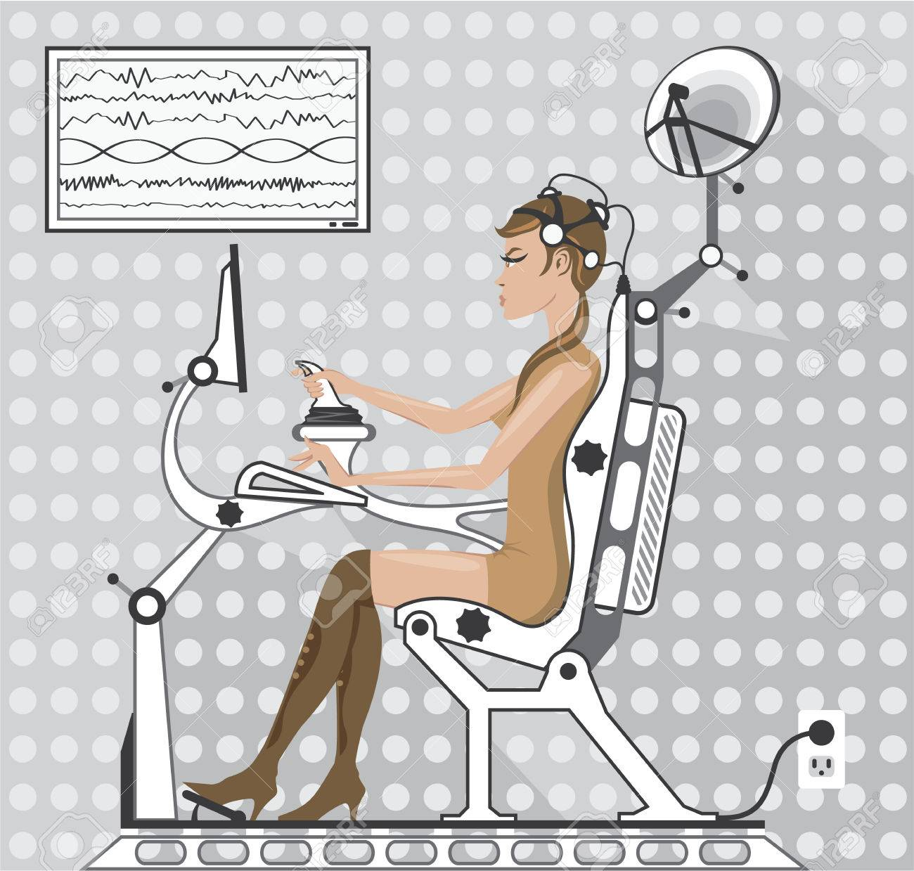
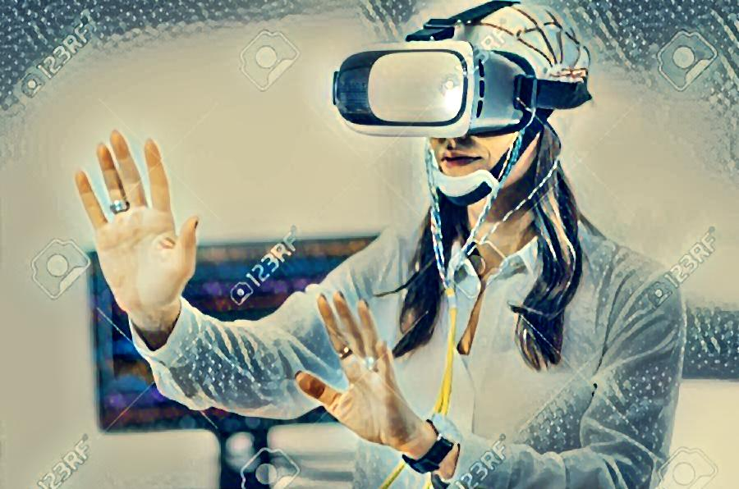
Examples of neural VR growing in the tech arena.
Neurorehabilitation is another promising area where Neural VR can be applied. A study done by Duke University used VR and brain-computer interfaces to treat physically-impaired patients. The 12-month study with 8 patients showed that VR can help aid in restoring ability with patients who suffer from a chronic spinal cord injury. They used a brain-machine interface and a VR headset to simulate neurological functions that allowed them to move their lower limbs. Scientists hope to make use of VR games to assist patients with illnesses ranging from Alzheimer’s to attention deficit hyperactivity disorder (ADHD).
Chang, C., Bang, K., Wetzstein, G., Lee, B., & Gao, L. (2021). Toward the next-generation VR/AR optics: a review of holographic near-eye displays from a human-centric perspective. Retrieved 8 June 2021, from https://doi.org/10.1364/OPTICA.406004
Fernandez-Vargas, Jacobo & Pfaff, Hanns & Rodríguez Ortiz, Francisco de Borja & Varona, Pablo. (2013). Assisted closed-loop optimization of SSVEP-BCI efficiency. Frontiers in neural circuits. 7. 27. 10.3389/fncir.2013.00027.

Slide 18
5G and the cloud
VR content is divided into ‘mobile’ and ‘tethered’ versions (the latter requiring a PC). Due to the differential in processing power between mobiles and PCs, this gives users a very different level of experience. Oculus have just launched a link for their mobile Quest headset so it can be used in both mobile and tethered mode but this is only a part of the solution.
The rollout of superfast low latency 5G services means we could bypass this problem by rendering content in the cloud and stream wirelessly to the headset. Google’s Stadia is already doing this for traditional gaming, and bringing this to VR will be the next logical extension, though will require further improvements to the technology.
Streaming would reduce the weight, cost and power consumption of headset devices. Whilst making accessing content easier and cheaper since it won’t require download and installing individual applications. Instead, it will enable ‘meta-verses’ connected VR experiences that we can seamlessly travel between like we browse internet services currently.
We imagine this is still probably 3-5 years away from commercial release, but will raise lots of interesting possibilities and also questions about who will own the platforms we all experience our digital world on.
W. (2019, November 25). What’s next for Virtual Reality. Mbryonic. https://mbryonic.com/advances-in-virtual-reality/

Slide 19
Examples of neural VR growing in the tech arena.
MindMaze is a neurorehabilitation company that is making waves in healthcare industries around the world. Combining neuroscience and virtual reality, the company develops a platform called MindMotion Pro that works to fix broken connections in the brain and help a patient’s brain and body bounce back from traumatic injuries and acute and chronic strokes. MindMotion Pro uses real-time motion capture sensors to map a patient’s movements onto a 3D avatar. The platform then guides the patient through customized exercise regimes based on neurorehabilitation principles in order to restore damaged neural pathways and form new ones. The interactive nature of MindMotion Pro is key to maximizing the benefits for stroke recovery patients. MindMotion Pro’s virtual-reality based games increase patient motivation and prolongs engagement in exercise repetition up to 15 times more than standard rehabilitation programs. The real-time multisensory feedback allows therapists to better customize treatment plans to patient performance.
Looxid Labs took a few more steps with this technology. Their system allows us to create our own VR environment with our thoughts. They achieved this using EEG sensors that we mentioned before. We don’t even need a gaming console, we can use our phone. They also implemented an eye-tracking feature that moves the game environment as our eyes move.
C. Chang, K. Bang, G. Wetzstein, B. Lee, and L. Gao, "Toward the next-generation VR/AR optics: a review of holographic near-eye displays from a human-centric perspective," Optica 7, 1563-1578 (2020).

Slide 20
Problems with previous vr headsets
A simple Google search shows the array of research undergoing on the vergence-accommodation problem. The problem can be simply described as when the brain mismatches cues between a 3D virtual object (the vergence) and the focusing distance (the accommodation). This has traditionally occurred with 3D cinema or any other stereoscopic images. The "accommodation" is the eye's natural adjustment of the lens of the eye to bring an object of different distances into focus. This can be seen in the image below, where the angle of divergence changes relative to the object's distance away from the eye.
In the real world, the accommodation and the vergence match, but in VR they are in conflict, and this can lead to eye strain and headaches as the eyes try to accommodate to a variety of distances rapidly. This can lead to other short-term effects when the user removes the headset such as blurriness. Before using a Virtual reality headset, the "inter-pupillary distance" should be measured – this distance is used to triangulate the distance to the eyes and the object. This helps improve the experience for the user by reducing the effect of this issue in VR.

Slide 21
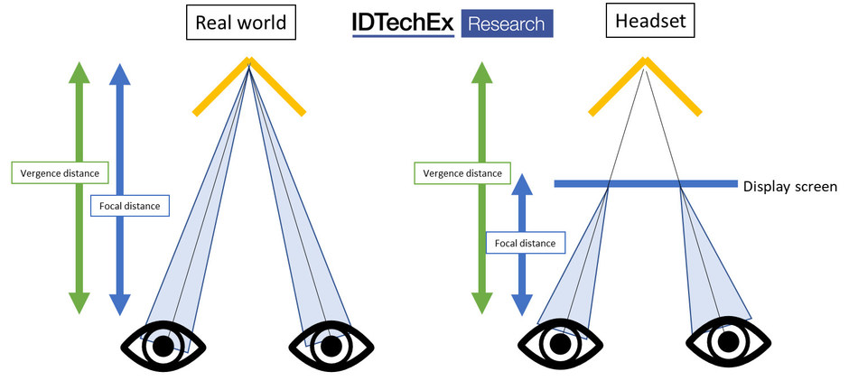
Problems with previous vr headsets
Another side-effect, which is seen more commonly with VR headsets, is motion sickness. This tends to be a result of latency, tracking and other such effects. Users are subject to a perception of moving but are not themselves moving, and this can lead to motion sickness because the image does not match the other sensory inputs from the user standing still. Similarly, if the user moves their head quickly, the image must match to their movement. A lag between the image and the movement could also lead to feeling motion sick whilst wearing a VR headset. This means that users may not wish to use the headset for an increased period, due to this side effect.
Augmented Reality, Virtual Reality, Mixed Reality, IDTechEx Asks What Can Be Improved in Report "Augmented, Mixed and Virtual Reality 2020-2030" (www.IDTechEx.com/ARVR)

Slide 22
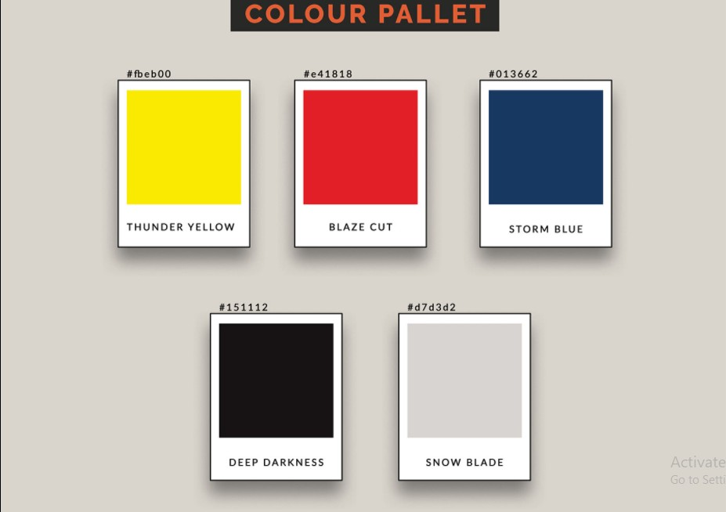

Slide 23
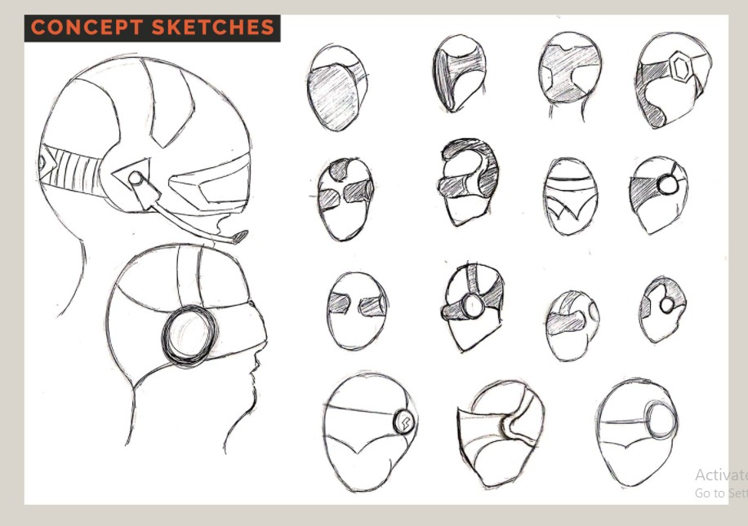

Slide 24
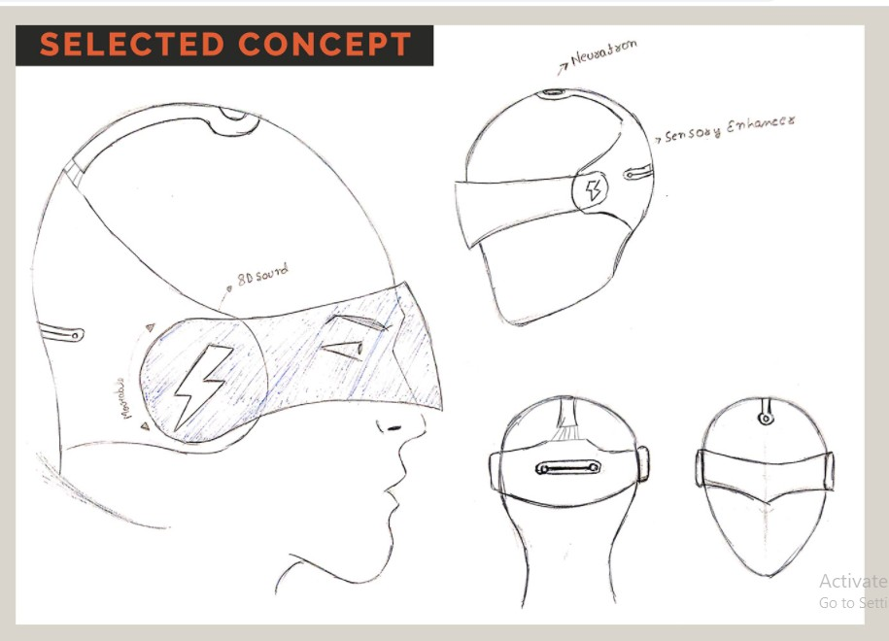

Slide 25
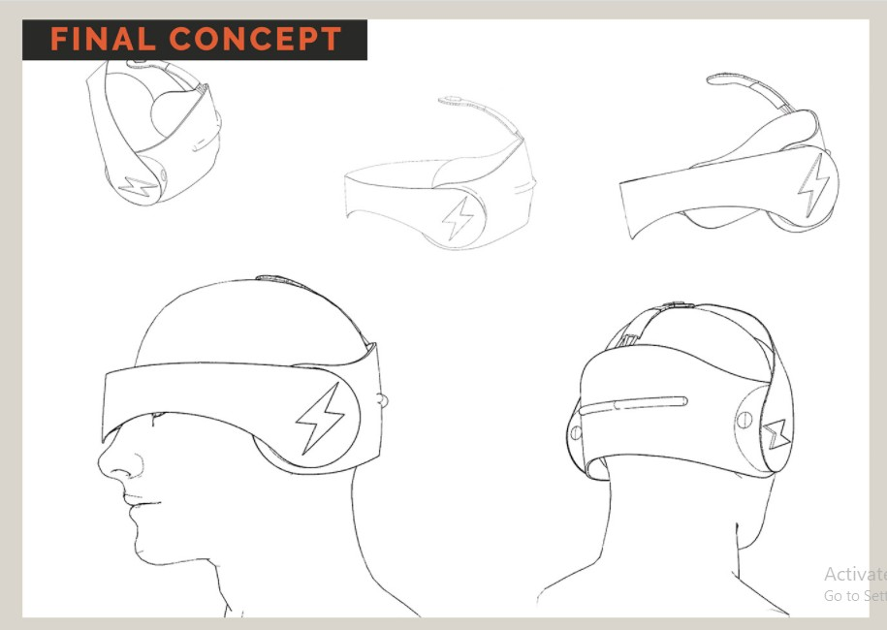

Slide 26
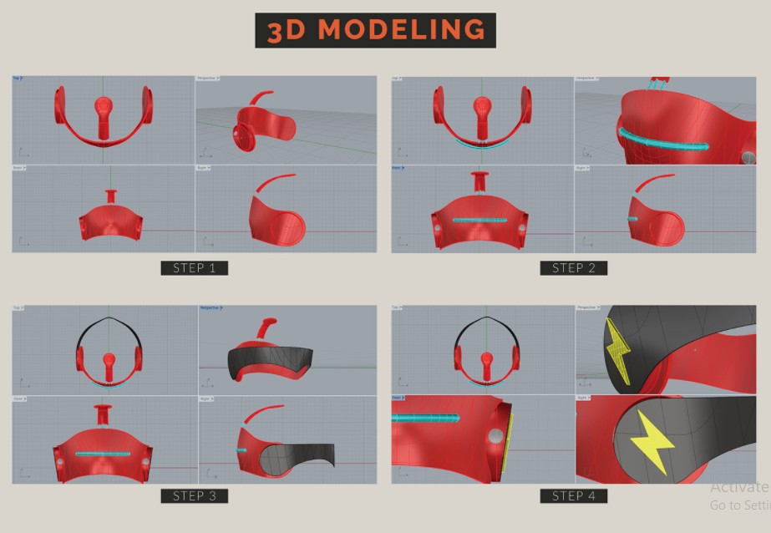

Slide 27
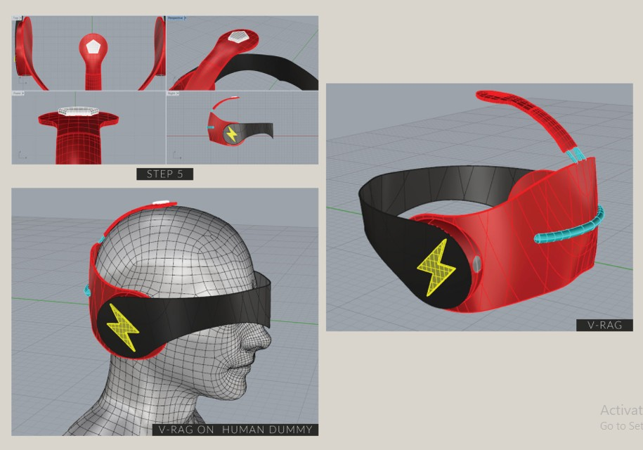

Slide 28
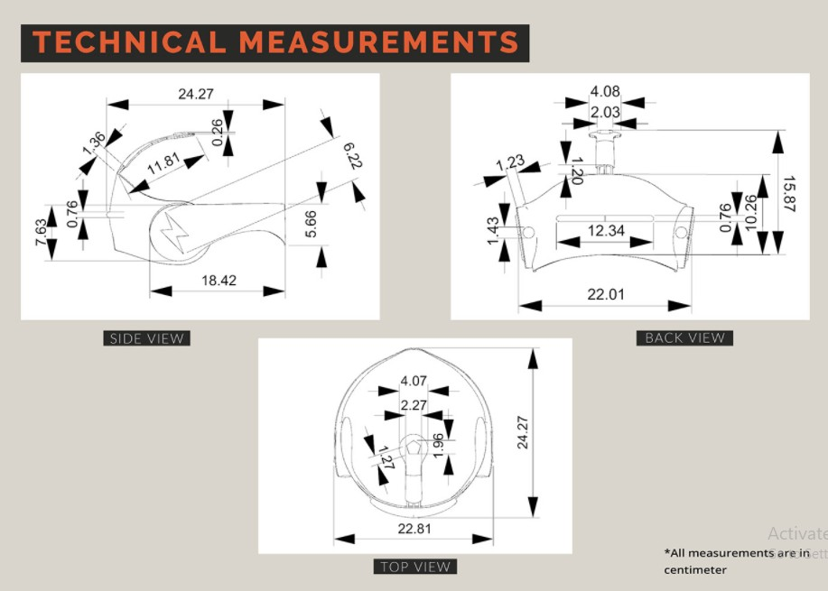

Slide 29
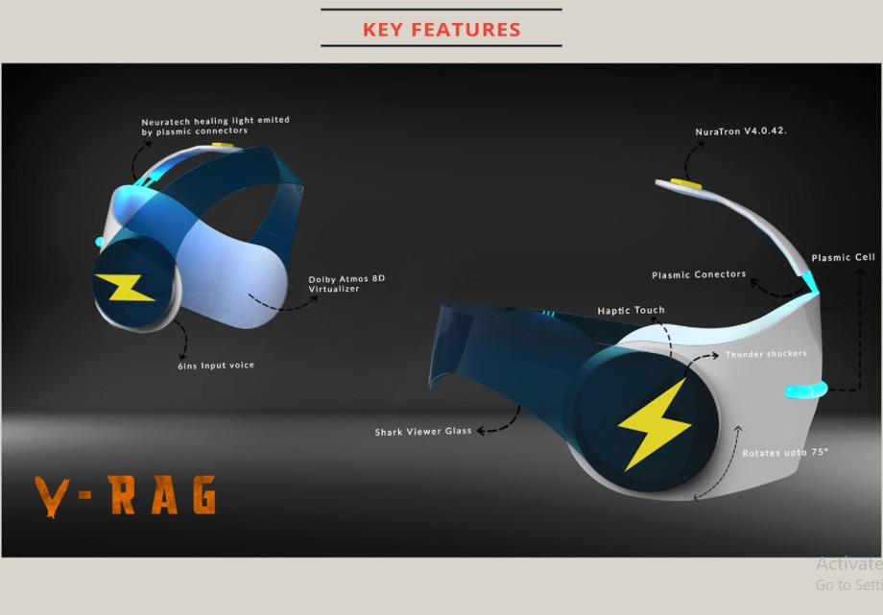
Stein, S. (2021). Prime Day 2021: 12 price drops available now, and 9 deals we expect soon. Retrieved 16 June 2021, from https://www.cnet.com/home/smart-home/amazon-prime-day-deals-now-and-more-soon/

Slide 30
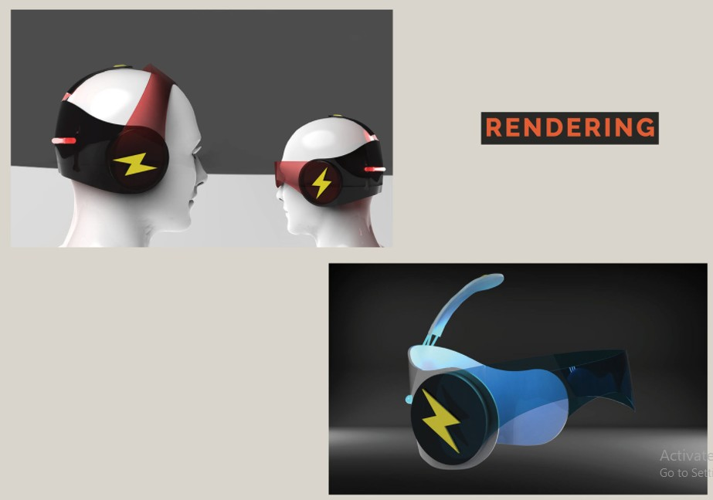
Improved Visuals
Comfort
User Interfaces
Social
5G and the cloud
Stein, S. (2021). Prime Day 2021: 12 price drops available now, and 9 deals we expect soon. Retrieved 16 June 2021, from https://www.cnet.com/home/smart-home/amazon-prime-day-deals-now-and-more-soon/

Slide 31
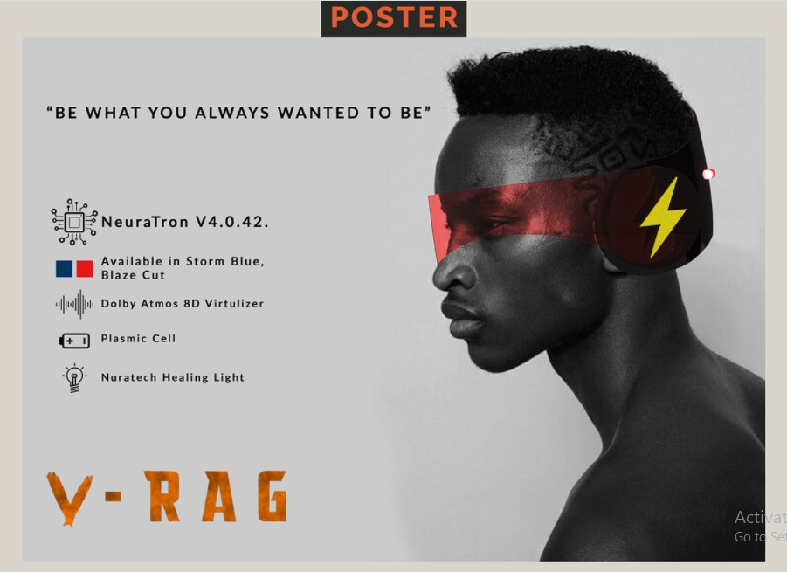
Stein, S. (2021). Prime Day 2021: 12 price drops available now, and 9 deals we expect soon. Retrieved 16 June 2021, from https://www.cnet.com/home/smart-home/amazon-prime-day-deals-now-and-more-soon/

Slide 32
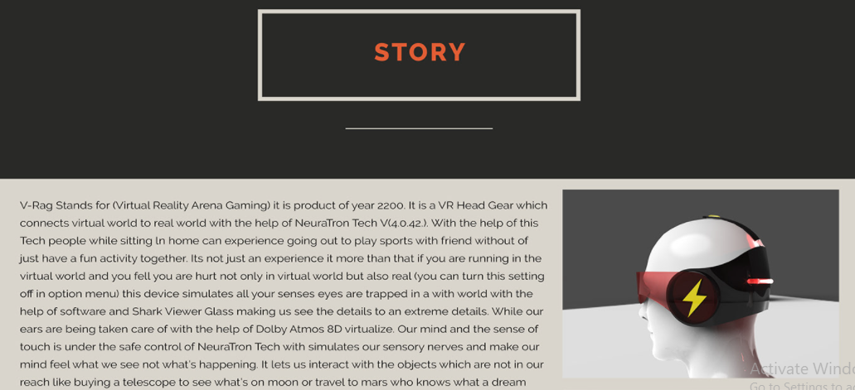
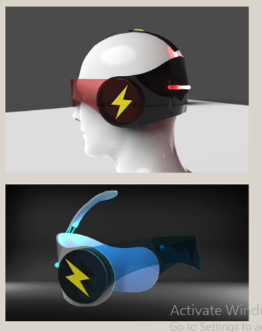
V-Rag Stands for (Virtual Reality Arena Gaming) it is a product of the year 2200. It is a VR Head Gear that connects the virtual world to the real world with the help of NeuraTron Tech VM4.0.42). We can turn this setting off in the options menu, this device simulates all our senses eyes are traPped in a with world with the help of software and Shark Viewer Glass help us see the details to extreme detail. While our ears are being taken care of with the help of Dolby Atmos 8D virtualize. Our mind and the sense of touch are under the safe control of NeuraTron Tech with the simulation of our sensory nerves and makes our mind feel what we see not what's happening. It has Connectivity features where we can add a friend from their account and only those people will be visible in our private world but if we are an extrovert don't worry it's has a public connectivity feature where we can feel free to roam and explore with our new fellow mates not now the people of E5 can use but also earth as it has own extreme connectivity range. It works on Plasmic Cell which has a battery life of 12 months or less depending on usage. The Shark Viewer Glass does need to be manually rotated or moved it works on just a tap behind the ears part. That touch feature used haptic feels The Plasmic cells emit light which is made into a healing light with the help of neurotech Plasrmic connectors placed behind connecting the main body of V-RAG to NeuraTron. It is completely lightweight.

Slide 33
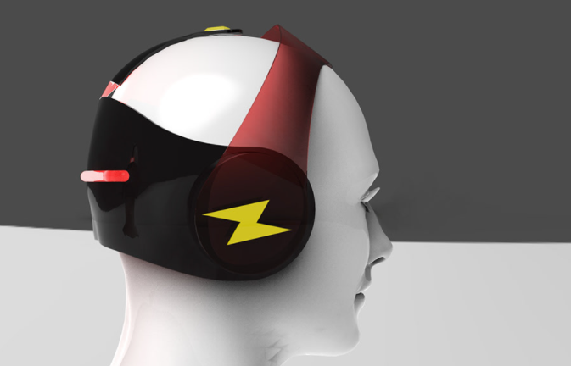
One method to overcome the vergence accommodation issue to have a field of view which focuses in and out depending on the user's viewpoint, this requires eye-tracking capabilities and specialised software. NVIDIA Near Eye Light Field Display prototype was introduced in 2013 which uses a microlens display to divide an image to individual light rays, and the display creates a light field directly in front of the user's eyes. This allows the user to focus on the different depths of the scene. Some other methods to overcome this problem are: to minimise the consequences by making exiting conflicts less common (e.g. increasing the distance to the virtual scene where possible), maximising the depth of other cues (e.g. shading realism, perspective, and other small visual cues), taking time for objects to move in and out of depth to give the users eyes time to adjust.

Slide 34
Bardi, J. (2021). What is Virtual Reality? VR Definition and Examples | Marxent. Retrieved 8 June 2021, from https://www.marxentlabs.com/what-is-virtual-reality/
Khanna, C. (2021). Virtual Reality and its Applications Across Industries. Retrieved 8 June 2021, from http://www.bodeanimation.com/blog/virtual-reality-and-its-applications-across-industries/
W. (2019, November 25). What’s next for Virtual Reality. Mbryonic. https://mbryonic.com/advances-in-virtual-reality/
Zanier, E. R. (2018, May 6). Virtual Reality for Traumatic Brain Injury. U.S. National Library of Medicine. https://www.frontiersin.org/articles/10.3389/fneur.2018.00345/full
Omejc, Nina & Rojc, Bojan & Battaglini, Piero & Marusic, Uros. (2018). Review of the therapeutic neurofeedback method using electroencephalography: EEG Neurofeedback. Bosnian Journal of Basic Medical Sciences. 19. 10.17305/bjbms.2018.3785.
Arrighi, Pierre & Maurya, Santosh & Mougenot, Céline. (2015). Towards Co-designing with Users: A Mixed Reality Tool for Kansei Engineering. 10.1007/978-3-319-33111-9_68.
Chang, C., Bang, K., Wetzstein, G., Lee, B., & Gao, L. (2021). Toward the next-generation VR/AR optics: a review of holographic near-eye displays from a human-centric perspective. Retrieved 8 June 2021, from https://doi.org/10.1364/OPTICA.406004
Fernandez-Vargas, Jacobo & Pfaff, Hanns & Rodríguez Ortiz, Francisco de Borja & Varona, Pablo. (2013). Assisted closed-loop optimization of SSVEP-BCI efficiency. Frontiers in neural circuits. 7. 27. 10.3389/fncir.2013.00027.
C. Chang, K. Bang, G. Wetzstein, B. Lee, and L. Gao, "Toward the next-generation VR/AR optics: a review of holographic near-eye displays from a human-centric perspective," Optica 7, 1563-1578 (2020).
Stein, S. (2021). Prime Day 2021: 12 price drops available now, and 9 deals we expect soon. Retrieved 16 June 2021, from https://www.cnet.com/home/smart-home/amazon-prime-day-deals-now-and-more-soon/
References

